Slide 1


Lecture 1
Introduction to data mining
Part B
Ioanna Miliou, PhD
Senior Lecturer, Stockholm University

Slide 2

Machine Learning
“Learning is any process by which a system improves performance from experience.”
- Herbert Simon

Slide 3
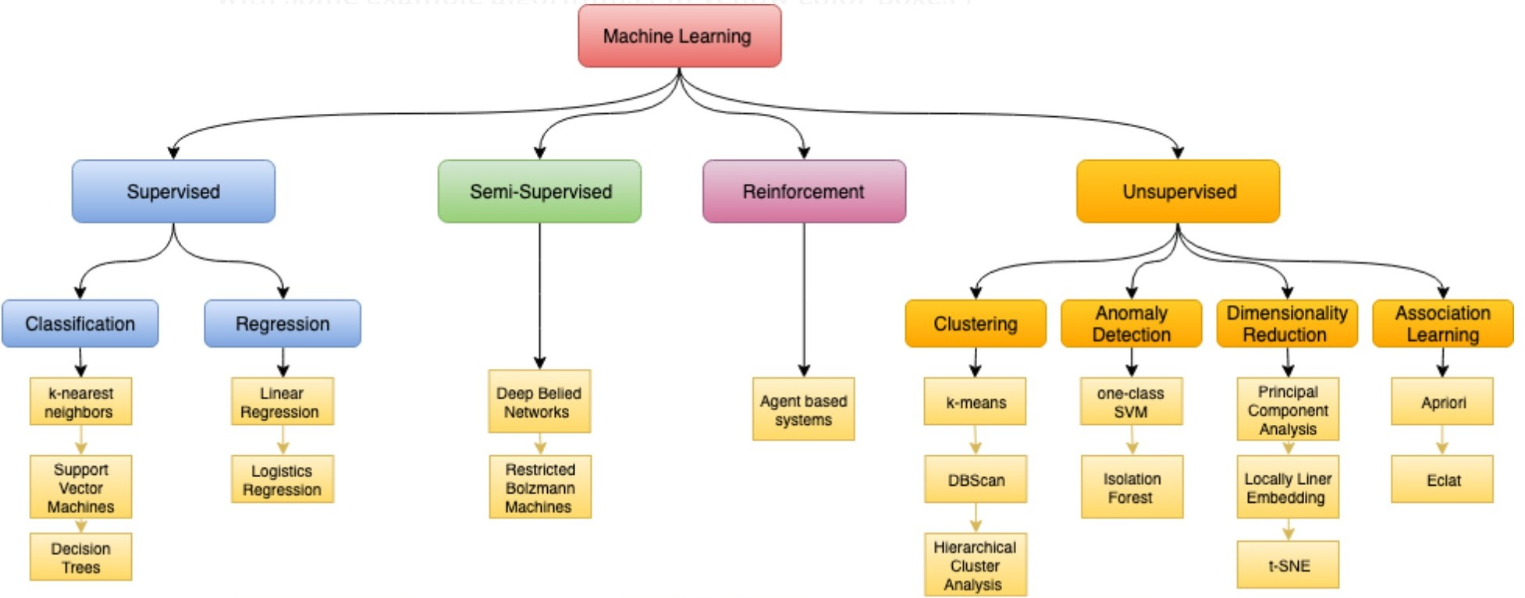
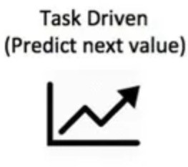
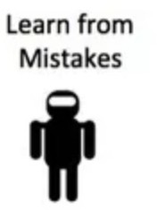
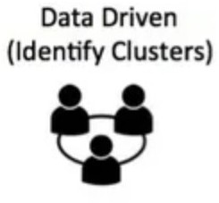
Types of Machine learning

Slide 4
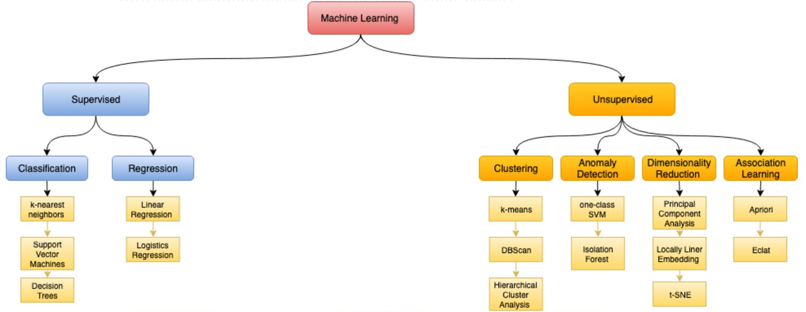
Our focus

Slide 5
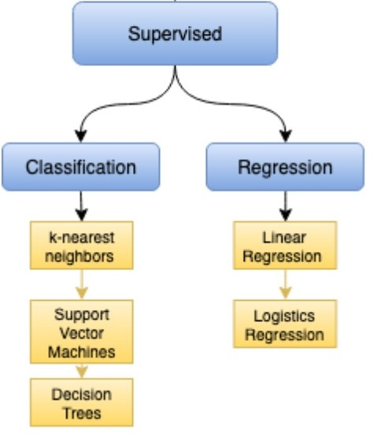
Supervised learning
Experience: objects that have been assigned class labels Performance: typically concerns the ability to classify new (previously unseen) objects
Predictive data mining

Slide 6
Predictive analytics
Extract rules
If occupation = banker, then salary > 60K SEK per month
Identify customers who will churn
If John stays on level 40 of Candy crush for more than 2 days, there is an 85% chance that he will stop playing
Predict the effectiveness of the treatment of a patient:
If a patient is given ”beta blockers” and “inhibitors” after heart failure, then the chance of survival in 1 year is 90%

Slide 7
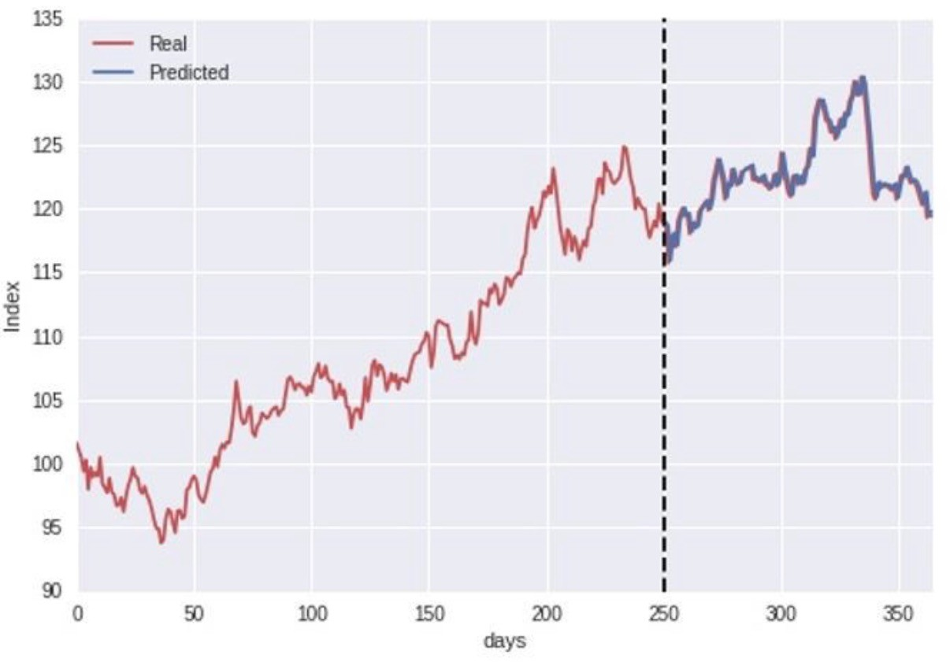
Time series prediction
Energy comsumption
Fault detection
Time to next failure

Slide 8
Our focus

Slide 9
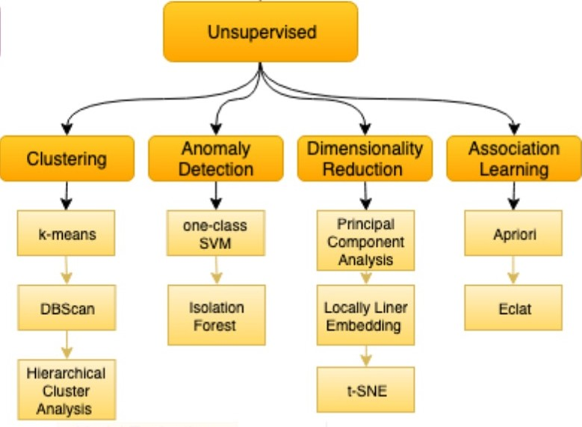
Unsupervised learning
Experience: objects for which no class labels have been given
Performance: typically concerns the ability to output useful characterizations (or groupings) of objects
Descriptive data mining

Slide 10
Descriptive analytics
Extract frequent patterns
There are lots of web documents where the following three words co-occur frequently: “Stockholm”, “Housing”, and “^#@$&^#$@”
Extract association rules
If a patient is diagnosed with Heart Failure, there is a 65% chance that the patient is prescribed with (RAS) inhibitors + beta blockers
Find groups of entities that are similar (clustering)
groups of Facebook users that have similar friends/interests
groups drugs that have similar side-effects
groups of patients with similar treatment pathways

Slide 11
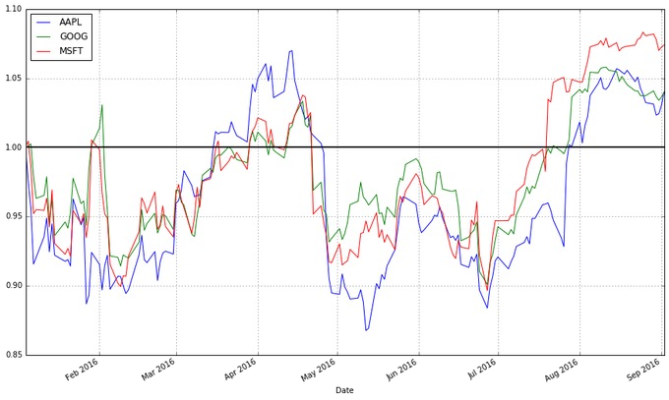
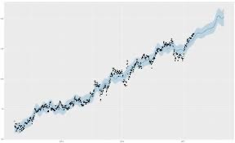
Finding groupings of stocks

Slide 12


OUTPUT
INPUT

Slide 13
Input: example
Features (attributes)
Class label
Email | All caps | No. excl. marks | Missing date | No. digits in From: | Image fraction | Spam
e1 | yes | 0 | no | 3 | 0 | yes
e2 | yes | 3 | no | 0 | 0.2 | yes
e3 | no | 0 | no | 0 | 1 | no
e4 | no | 4 | yes | 4 | 0.5 | yes
e5 | yes | 0 | yes | 2 | 0 | no
e6 | no | 0 | no | 0 | 0 | no
Examples (observations)

Slide 14
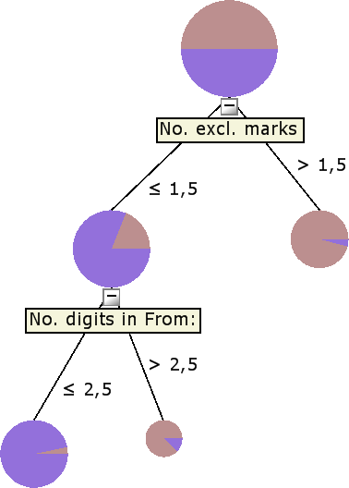
Output: example
Task:
Using the input examples (emails in training set)
Build a model for predicting the class label (spam)
Spam = yes
Spam = yes
Spam = no

Slide 15
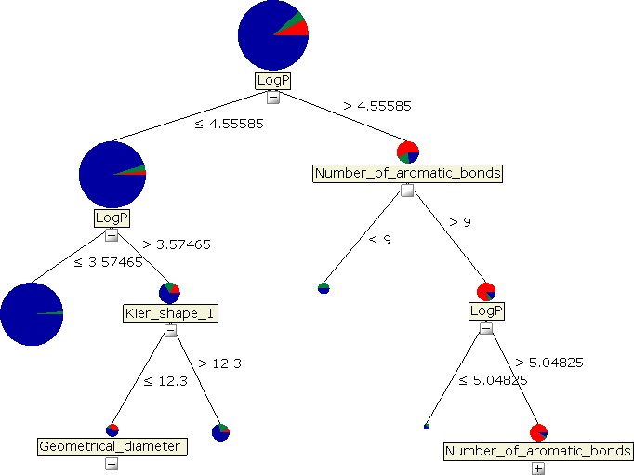
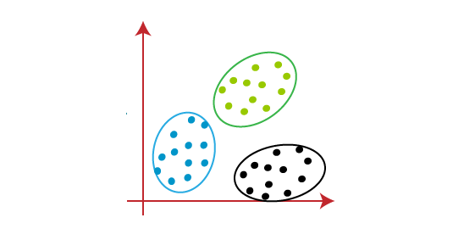
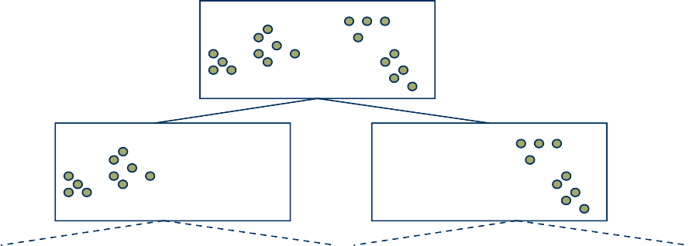
Output: more examples
Interpretable representation of findings
- equations, rules, decision trees, clusters
y = 0.25 + 4.5x₁ − 2.2x₂ + 3.1x₃
if x₁ > 3.0 & x₂ ≤ 1.8 then y = 1.0
BuysMilk & BuysCereals → BuysJuice [Support : 0.05, Confidence : 0.85]

Slide 16
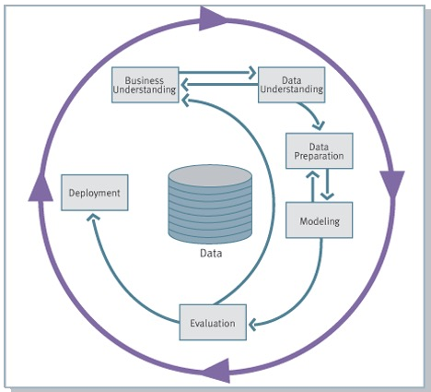
CRISP-DM:
CRoss Industry Standard Process for Data Mining
Shearer C., “The CRISP-DM model: the new blueprint for data mining”, Journal of Data Warehousing 5 (2000)

Slide 17
CRISP-DM
Business Understanding
understand the project objectives and requirements from a business perspective
convert this knowledge into a data mining problem definition
create a preliminary plan to achieve the objectives

Slide 18
CRISP-DM
Data Understanding
initial data collection
get familiar with the data
identify data quality problems
discover first insights
detect interesting subsets
form hypotheses for hidden information

Slide 19
CRISP-DM
Data Preparation
construct the final dataset to be fed into the machine learning algorithm
tasks here include: table, record, and attribute selection, data transformation and cleaning

Slide 20
CRISP-DM
Modeling
various data mining techniques are selected and applied
parameters are learned
some methods may have specific requirements on the form of input data
going back to the data preparation phase may be needed

Slide 21
CRISP-DM
Evaluation
current model should have high quality from a data mining perspective
before final deployment, it is important to test whether the model achieves all the business objectives

Slide 22
CRISP-DM
Deployment
just creating the model is not enough
the new knowledge should be organized and presented in a usable way
generate a report
implement a repeatable data mining process for the user or the analyst

Slide 23


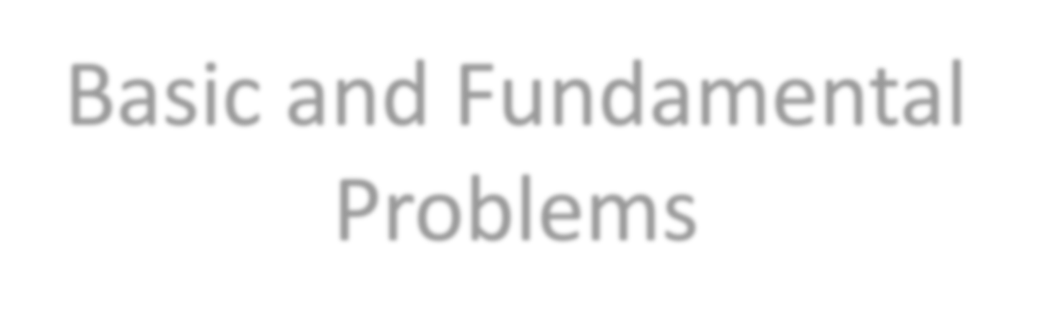
Basic and Fundamental Problems

Slide 24
Finding the majority element
Given a set of labeled elements, e.g.,
{C, B, C, C, A, C, C, A, B, C, …}
Identify the majority element: element that occurs more than 50% of the time (assuming there exists one)
How can you find it?
… using no more than a few memory locations?

Slide 25
Finding the majority element
(solution: Boyer-Moore’s Algorithm)
A = first item you see; count = 1
for each subsequent item B
if (A==B) count = count + 1
else {
count = count - 1
if (count == 0) { A=B;
count = 1
}
}
endfor
Every time you see the same element increase the counter
Every time you see a different element decrease the counter
If the counter becomes 0, replace the element and set the counter back to 1

Slide 26

Finding a number in the top half
Given a set of N numbers (N is very large)
Find a number x such that x is *likely* to be larger than the median of the numbers
Simple solution?
Sort the numbers and store them in sorted array A
Any value larger than A[N/2] is a solution
Other solutions?

Slide 27
Finding a number in the top half efficiently
A solution that uses small number of operations
Randomly sample K numbers from the file
Output their maximum
median
N/2 items
N/2 items
Failure probability p = (1/2)^{K}
If K = 10, then p = 0.0009765625

Slide 28
The Set Cover Problem
A trickier data mining task…
A common algorithmic problem…
One of the MOST USEFUL problems in Computer Science!

Slide 29
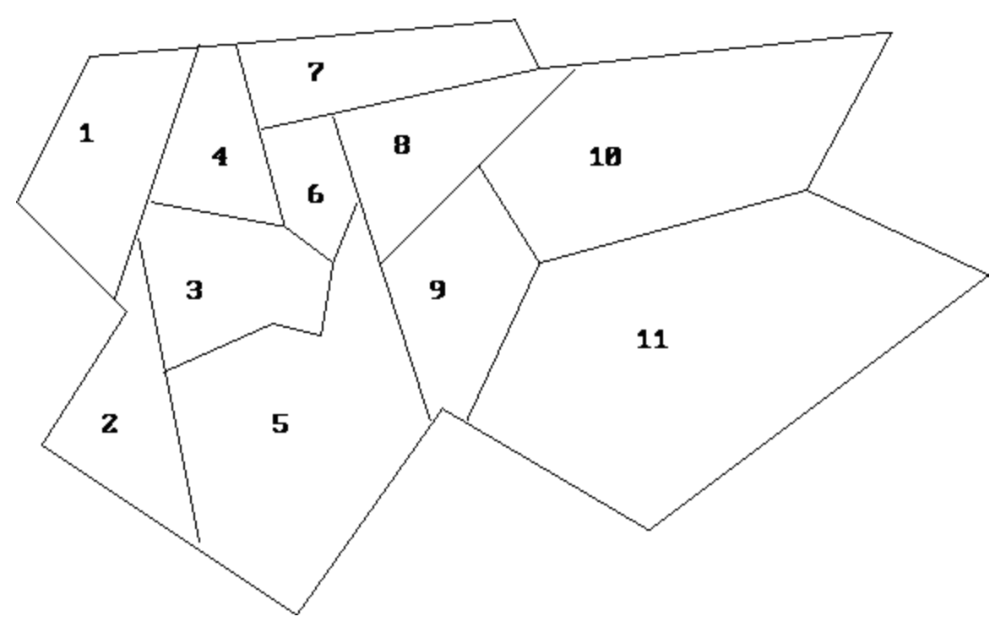
The Set Cover Problem: Example I
The mayor of a city wants to place fire stations to cover each neighborhood
Each fire station covers:
own neighborhood
all adjacent ones
Challenge:
Where shall we place the fire stations to minimize the city’s expenses?
Each fire station costs X SEK per month

Slide 30
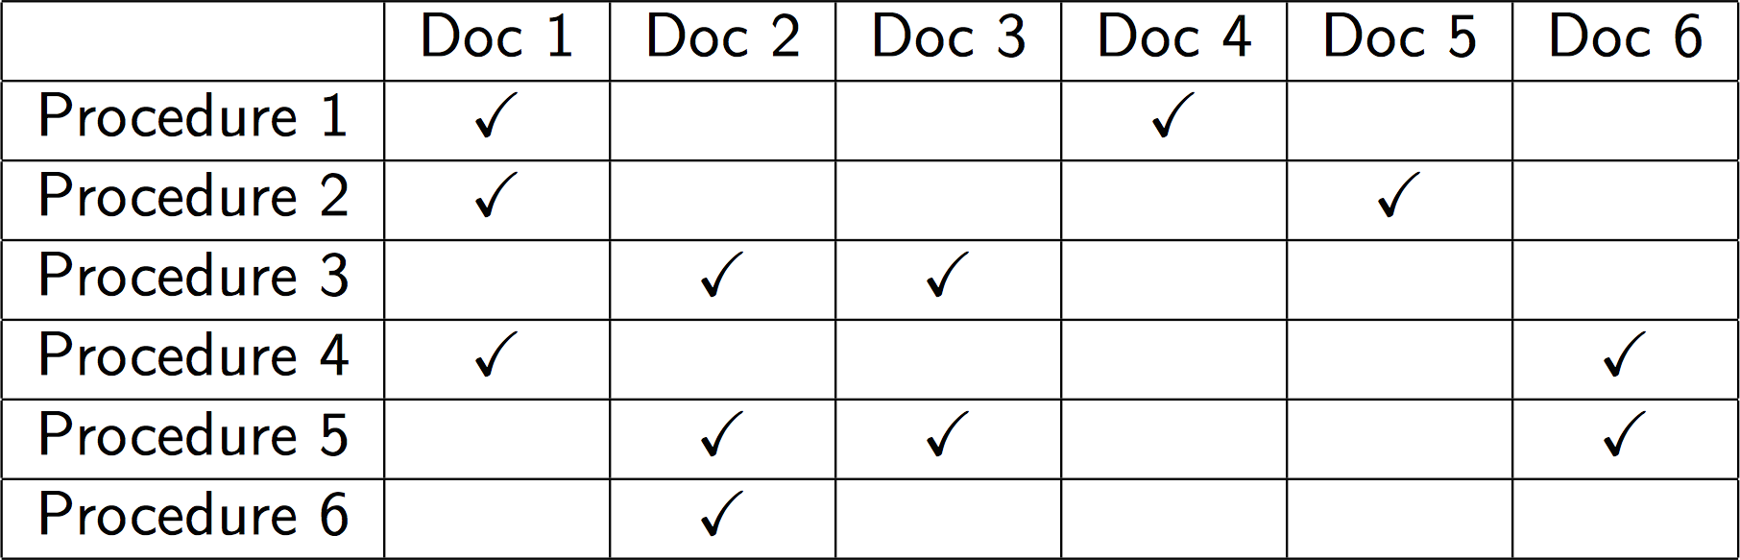
The Set Cover Problem: Example I
A hospital ER needs to keep doctors on call
A qualified individual is available to perform every medical procedure that might be required (there is an official list of such procedures)
For each procedure:
Several doctors can be available on-call duty
Additional salary needs to be paid
Goal: Choose doctors so that each procedure is covered at a minimum cost!

Slide 31
The Set Cover Problem: Example II
IBM wants to identify computer viruses
Elements: 5000 known viruses (their machine code)
Sets: 9000 substrings of 20 or more consecutive bytes from viruses, not found in ‘good’ code
A set cover of 180 was found!
It suffices to search for these 180 substrings to verify the existence of known computer viruses

Slide 32
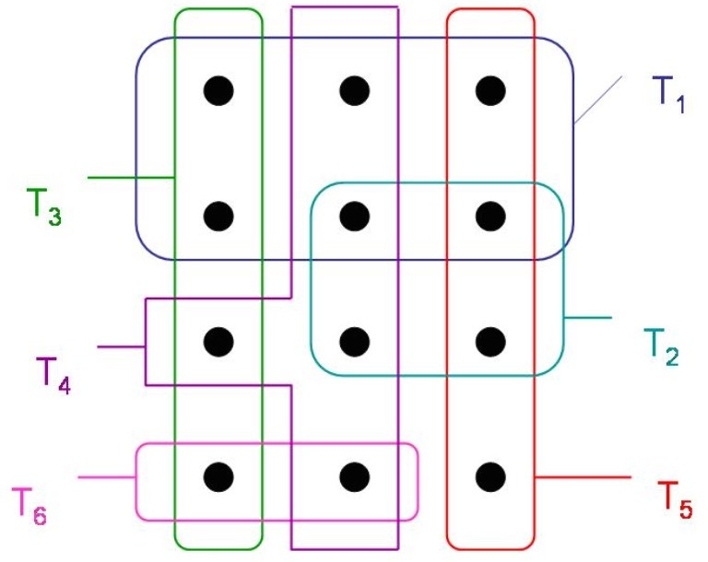
The Set Cover Problem
A set of objects
Some sets T that cover the objects
Find the set of Ts that cover all objects!
Find the smallest set!

Slide 33
Formal Definition
Setting:
Universe of m elements U = {U₁,…,U_{m}}
A set of n sets T = {T₁,…,T_{n}}
Find a collection C of sets in T (C subset of T) such that C contains all elements from U

Slide 34
Formal Definition
Set-cover problem: Find the smallest collection C of sets from T such that all elements in the universe U are covered
Solution?
Try all sub-collections of T
Select the smallest one that covers all the elements in U
The running time of the trivial algorithm is O(2^{n}|U|)
This is way too slow

Slide 35
Formal Definition
Set-cover problem: Find the smallest collection C of sets from T such that all elements in the universe U are covered
The set cover problem is NP-hard
Simple approximation algorithms with provable properties are available and very useful in practice

Slide 36
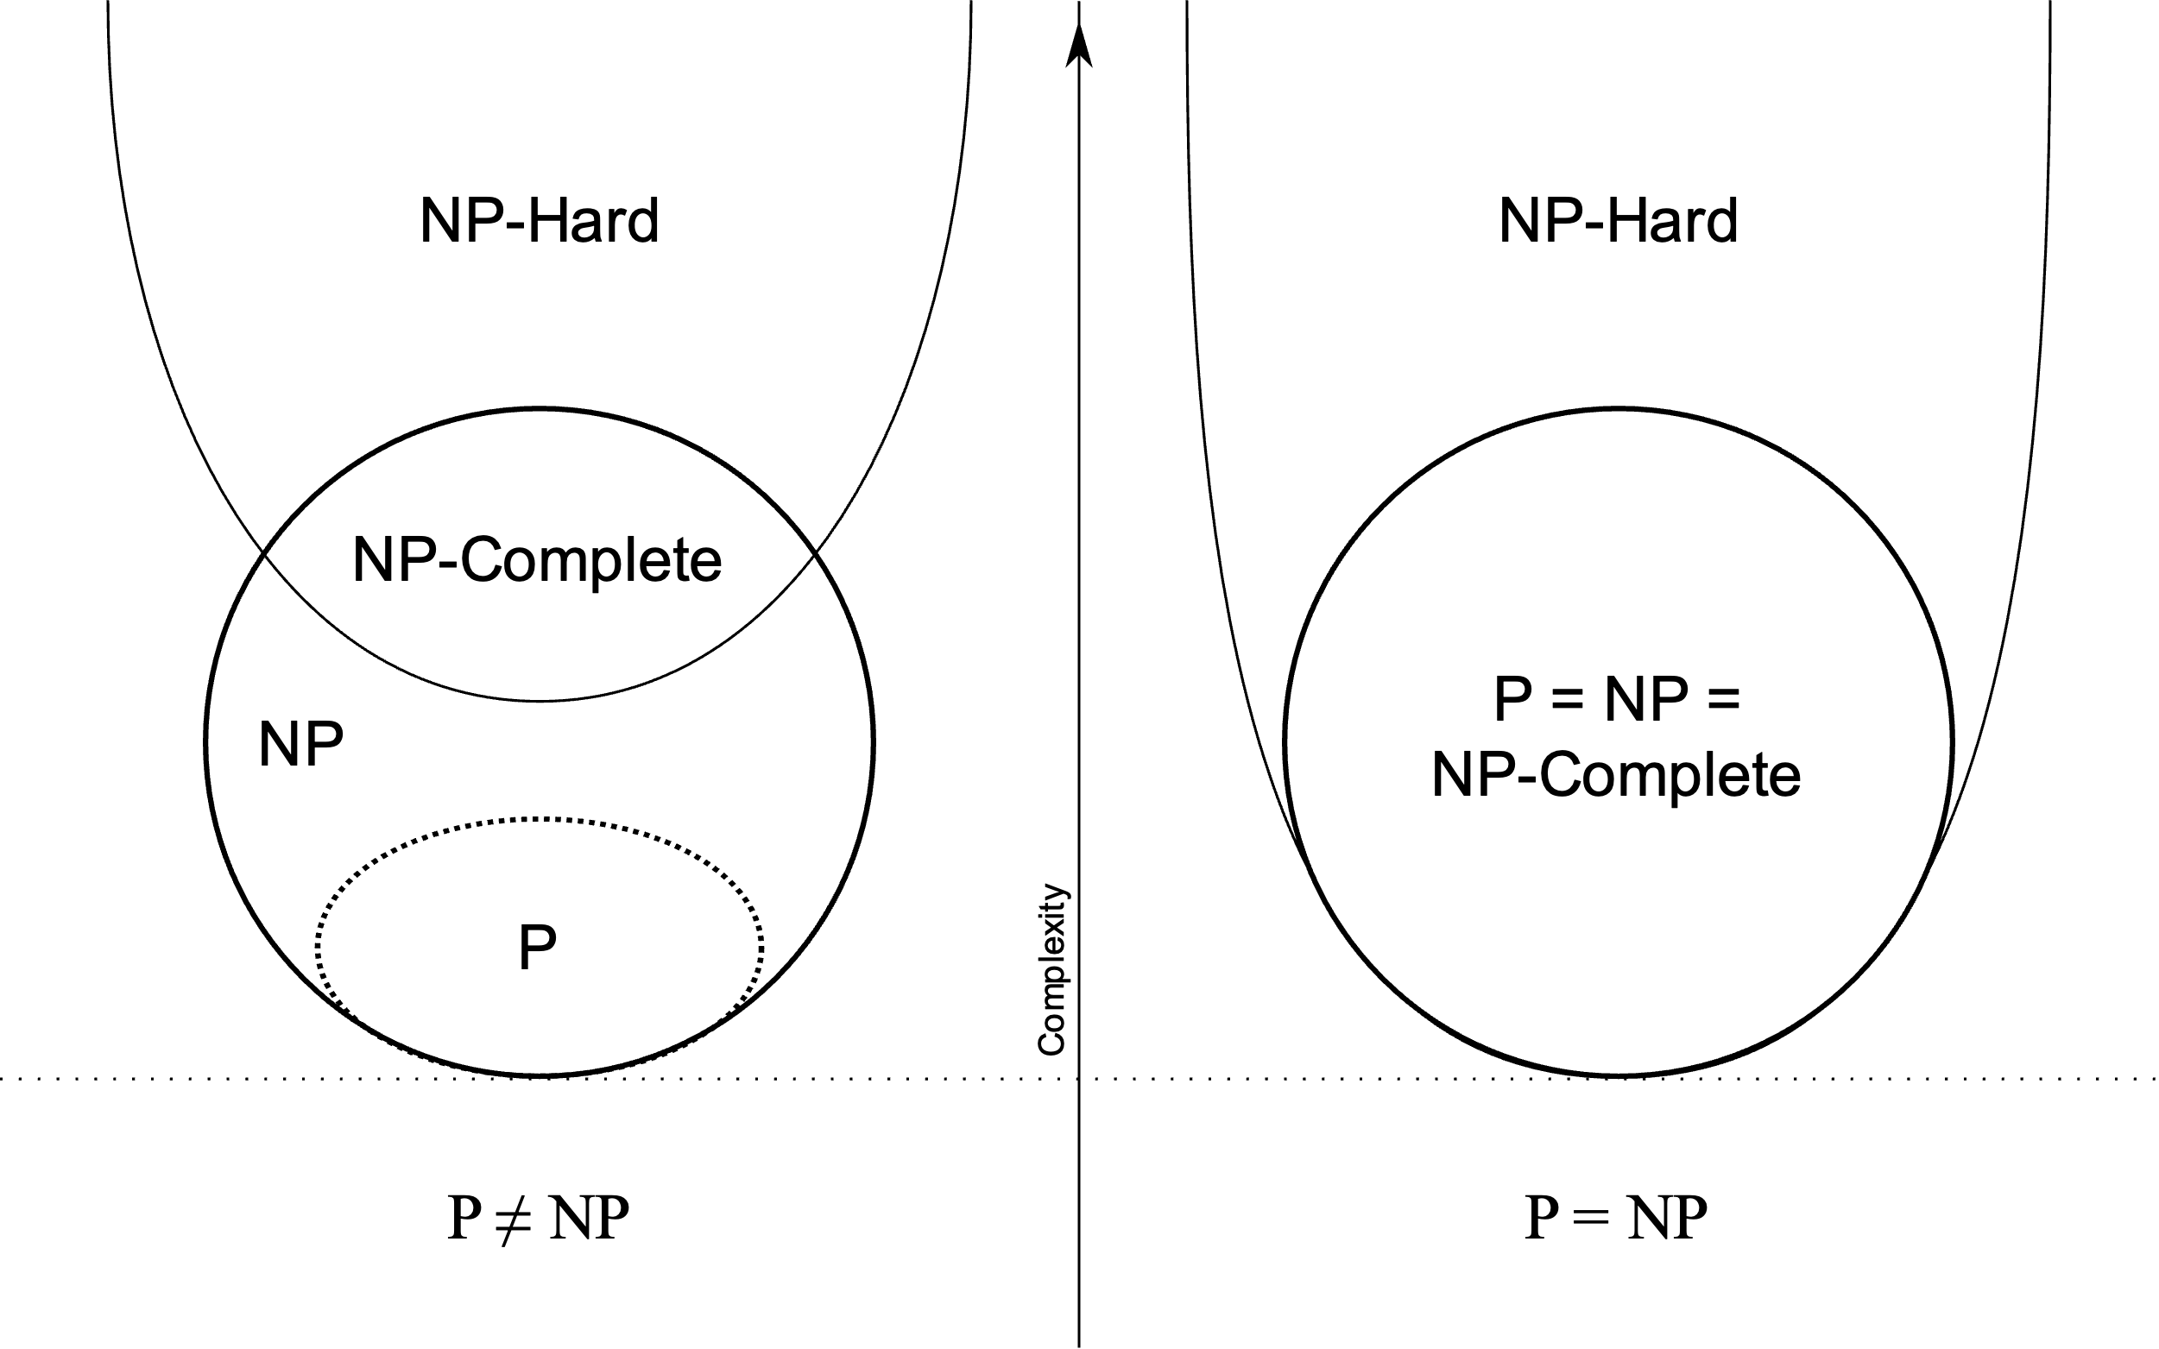
NP-hardness

Slide 37

NP-hardness

Slide 38
Greedy algorithm for set cover
Select first the largest-cardinality set t from T
Remove the elements of t from U
Re-compute the sizes of the remaining sets in T
Go back to the first step

Slide 39
The Greedy algorithm
X = {}
While U is not empty do
For all tєT let a_{t}=|t intersection |
Let t be such that a_{t} is maximal
X = X U {t}
U = U\ t

Slide 40
Recall…
We want to find a set of Ts such that will cover all the objects
What would the greedy algorithm find?

Slide 41
Example
Select biggest set: T₁
Remove all elements covered by T₁
Current solution:
X = {T₁}

Slide 42
Example
Select the next biggest set: T₄
Remove all elements covered by T₄
Current solution:
X = {T₁}

Slide 43
Example
Select the next biggest set: T₅
Remove all elements covered by T₅
Current solution:
X = {T₁, T₄}

Slide 44
Example
Select the next biggest set: T₅
Remove all elements covered by T₅
Current solution:
X = {T₁, T₄, T₅}

Slide 45
Example
Select the next biggest set: T₆
Remove all elements covered by T₆
Current solution:
X = {T₁, T₄, T₅}

Slide 46
Example
Select the next biggest set: T₆
Done!
Current solution:
X = {T₁, T₄, T₅, T₆}

Slide 47
Example
What is the optimal solution?
Recall: we want the smallest possible set!
An optimal solution:
X* = {T₃, T₄, T₅}
Greedy solution:
X = {T₁, T₄, T₅, T₆}

Slide 48





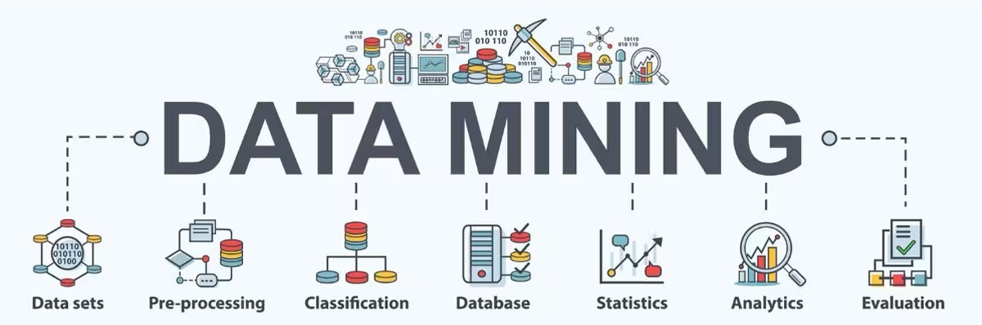
Today…
Why do we need
Data Analysis?
What is
Data Mining?
What are the types of Machine Learning?
Examples where Data Mining has been useful
Some (basic) Data Mining prototype problems

Slide 49



TODOs
Reading:
Main course book: Chapter 1
Lab 0
Recommended to complete the lab before the end of the week
Quiz 1

Slide 50















Coming up next
Wednesday
Sept 4
Dimensionality Reduction
Sep 7
Clustering I
Lab 0 – Introduction to Python
Next week
Lecture 2 – Association Rules
Thursday
Lab 1 – Data Exploration
Sep 6

